Slide 1
Frutal.com
Bringing market to the doorstep…
TEAM MATES:
1.RANGANATH G.
2.HARSHAL YADAV
3.SUSHREE SANGEETA JENA
4.SWETASMITA PRUSTY

Slide 2
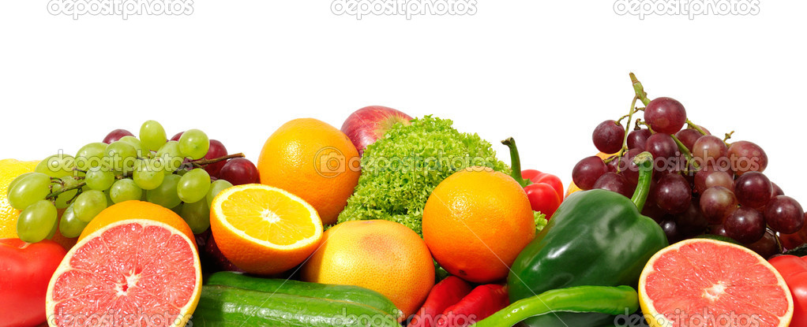


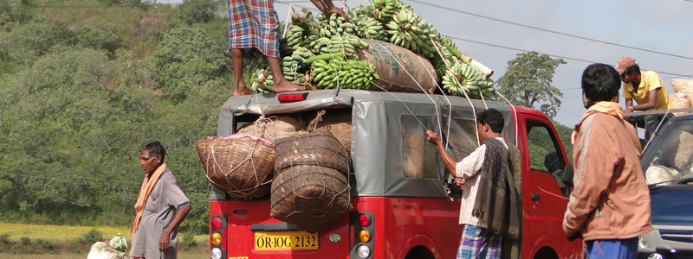
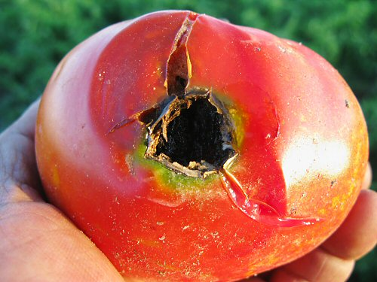
High per capita
Increased value in terms of nutrition
Post harvest l osses
Poor supply chain
perishable
Why Fruits And Vegetables??

Slide 3
OBJECTIVES:
Matching demand and supply of F & V.
Mapping of producers and consumers reducing market interference.
Value added services for buyers as well as sellers.
Pre harvest deal.
Quality issues

Slide 4
Value Proposition For Sellers
Value Proposition For Buyers
Gain creators
Gain creators
Assured Market
Quality Produce
P & S
Payment Guarantee
P & S
Trusted Delivery
Better Price
Proximal Choices
Due Diligence of Quality
Logistics
Lower price
Farm gate
Procurement
Pre-Harvest
deal
Pain Relievers
Pain Relievers
Eliminates market
intermediation
Decreased Logistic costs

Slide 5




Geo-tagging
Bank
Sale price+Logistic cost +2% service chgs
FARMER
register
register
Required info
Request booking
BUYER
book
Logistic services
(Optional)
Rating system

Slide 6
How The Venture Works???
APP building
Staff recruitment
Logistics provider
Tie-up
Farmers & Buyers tracking
(using Farmers groups, SHG’s, Print Ads…)
1st month
50 Farmers
20 Buyers
10 Transactions
Revenue
6th month
120 Farmers
50 Buyers
60-70 Transactions
Revenue
1 yr
200 Farmers
130 Buyers
100 Transactions
Revenue

Slide 7


Call us on suppliers buyers
1008956223
Log in
Register
Enquiry
log in
SELL for free
Mandi rates
View buyer queries
Frutal.com
Bringing market to the doorstep…
Search for products here…
Address:near Gandhi Garden,Oil India Petrol Pump,Nagpur. Pin:756100, email:frutalapp@yahoo.com,
visit us at:www.frutalapp.com

Slide 8

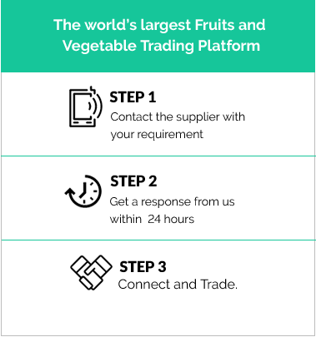

Register
Service platform at your doorstep
Product
name
Time of
harvest
Acreage
Contact no.
SUBMIT

Slide 9
Register
Farmers in the
vicinity
1.Qwwee,50kilo ,
Within 25 km.
2.Abc,10 kilo ,
within 30 km.
3.Cvb,65 kilo,
Within 36 km.
4.Hil,28 kilo,
Within 50 km.
Service platform at your doorstep
Product
name
Quantity
Location
Contact no.
Logistics
Y
N
SUBMIT
Selects farmer as required. Once selected auto sms to farmers and us that buyer is ready.

Slide 10


